Slide 1


Using A computer security tool
The how to’s by Keanu Chetty

Slide 2


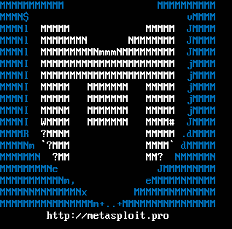

How I ran the software on my MAC
This Photo by Unknown Author is licensed under CC BY-SA
I decided to use Metasploit as my computer tool but could not directly download it onto my mac. So I decided to install VirtualBox and run Metasploit through Kali Linux
This Photo by Unknown Author is licensed under CC BY-SA
This Photo by Unknown Author is licensed under CC BY-SA

Slide 3

Why I chose to use Kali Linux and to use Metasploit
I chose to use Kali Linux because it came with Metasploit already downloaded and a variety of other exploit tools I could learn from.
It was also easy to download onto my virtual box and allowed me to start using exploits immediately.
I found Metasploit was easier to understand and use compared to its competition burp suite, both of them are already installed in Kali Linux but I preffered Metasploit.
This Photo by Unknown Author is licensed under CC BY-SA

Slide 4
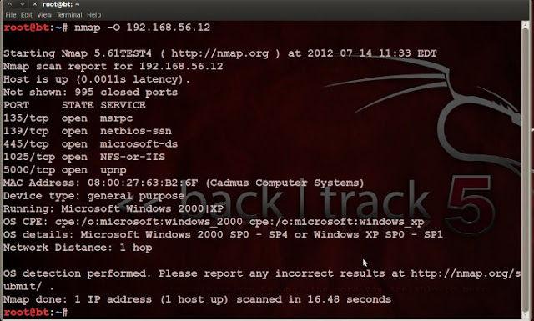
What is Metasploit
Metasploit
Metasploit Framework is an open-source.
Supports the testing of large networks through CIDR identifiers
Has quick generation payloads
Metasploit leaves the target system stable in many cases
Metasploit exploits vulnerabilities.
This Photo by Unknown Author is licensed under CC BY-SA

Slide 5
Metasploit vs burp suite
Metasploit
Burp Suite
Pro’s:
Scans networks for new or existing vulnerabilities in systems .
Automation of manual tests and exploits.
Reduced days work into a few hours.
Metasploit is an integral part in testing new systems and validating them.
Pro’s
Very quick to run web attacks
Very thorough attacks
When attacking a website it spiders the webpage and finds most pages associated with that webpage quickly.
It allows you to be selective of which web pages you attack, you do not need to attack all that where found in the scan.

Slide 6


Where do I start
The best place to start would be to open Kali Linux and in the top search bar, Search Metasploit and select it.
This Photo by Unknown Author is licensed under CC BY-NC

Slide 7
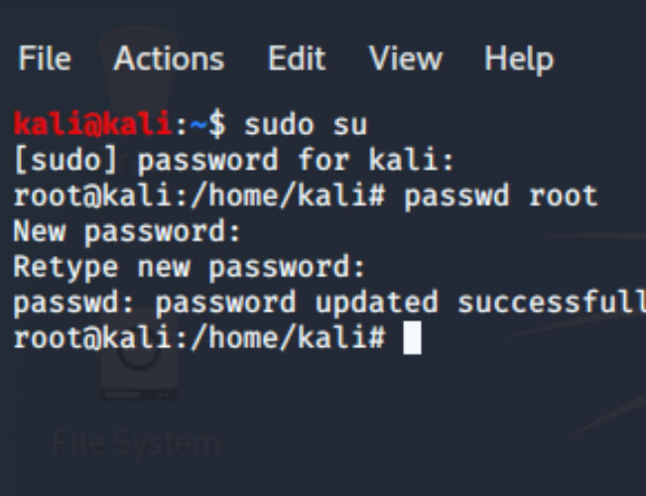
Common issue and my solution
As I begun to attempt to use Metasploit, a lot of my commands because I didn’t have Administer access to my virtual machine. So the fist thing I did was change my user privilege's so that I had administered privileges.
I used the command “Sudo su” , this command then prompted me to input my user password, after that I used the command “Passwd root” which allowed me to put a new password for the administer user.
The $ symbol shows that I have simple user access and the # symbol shows that

Slide 8
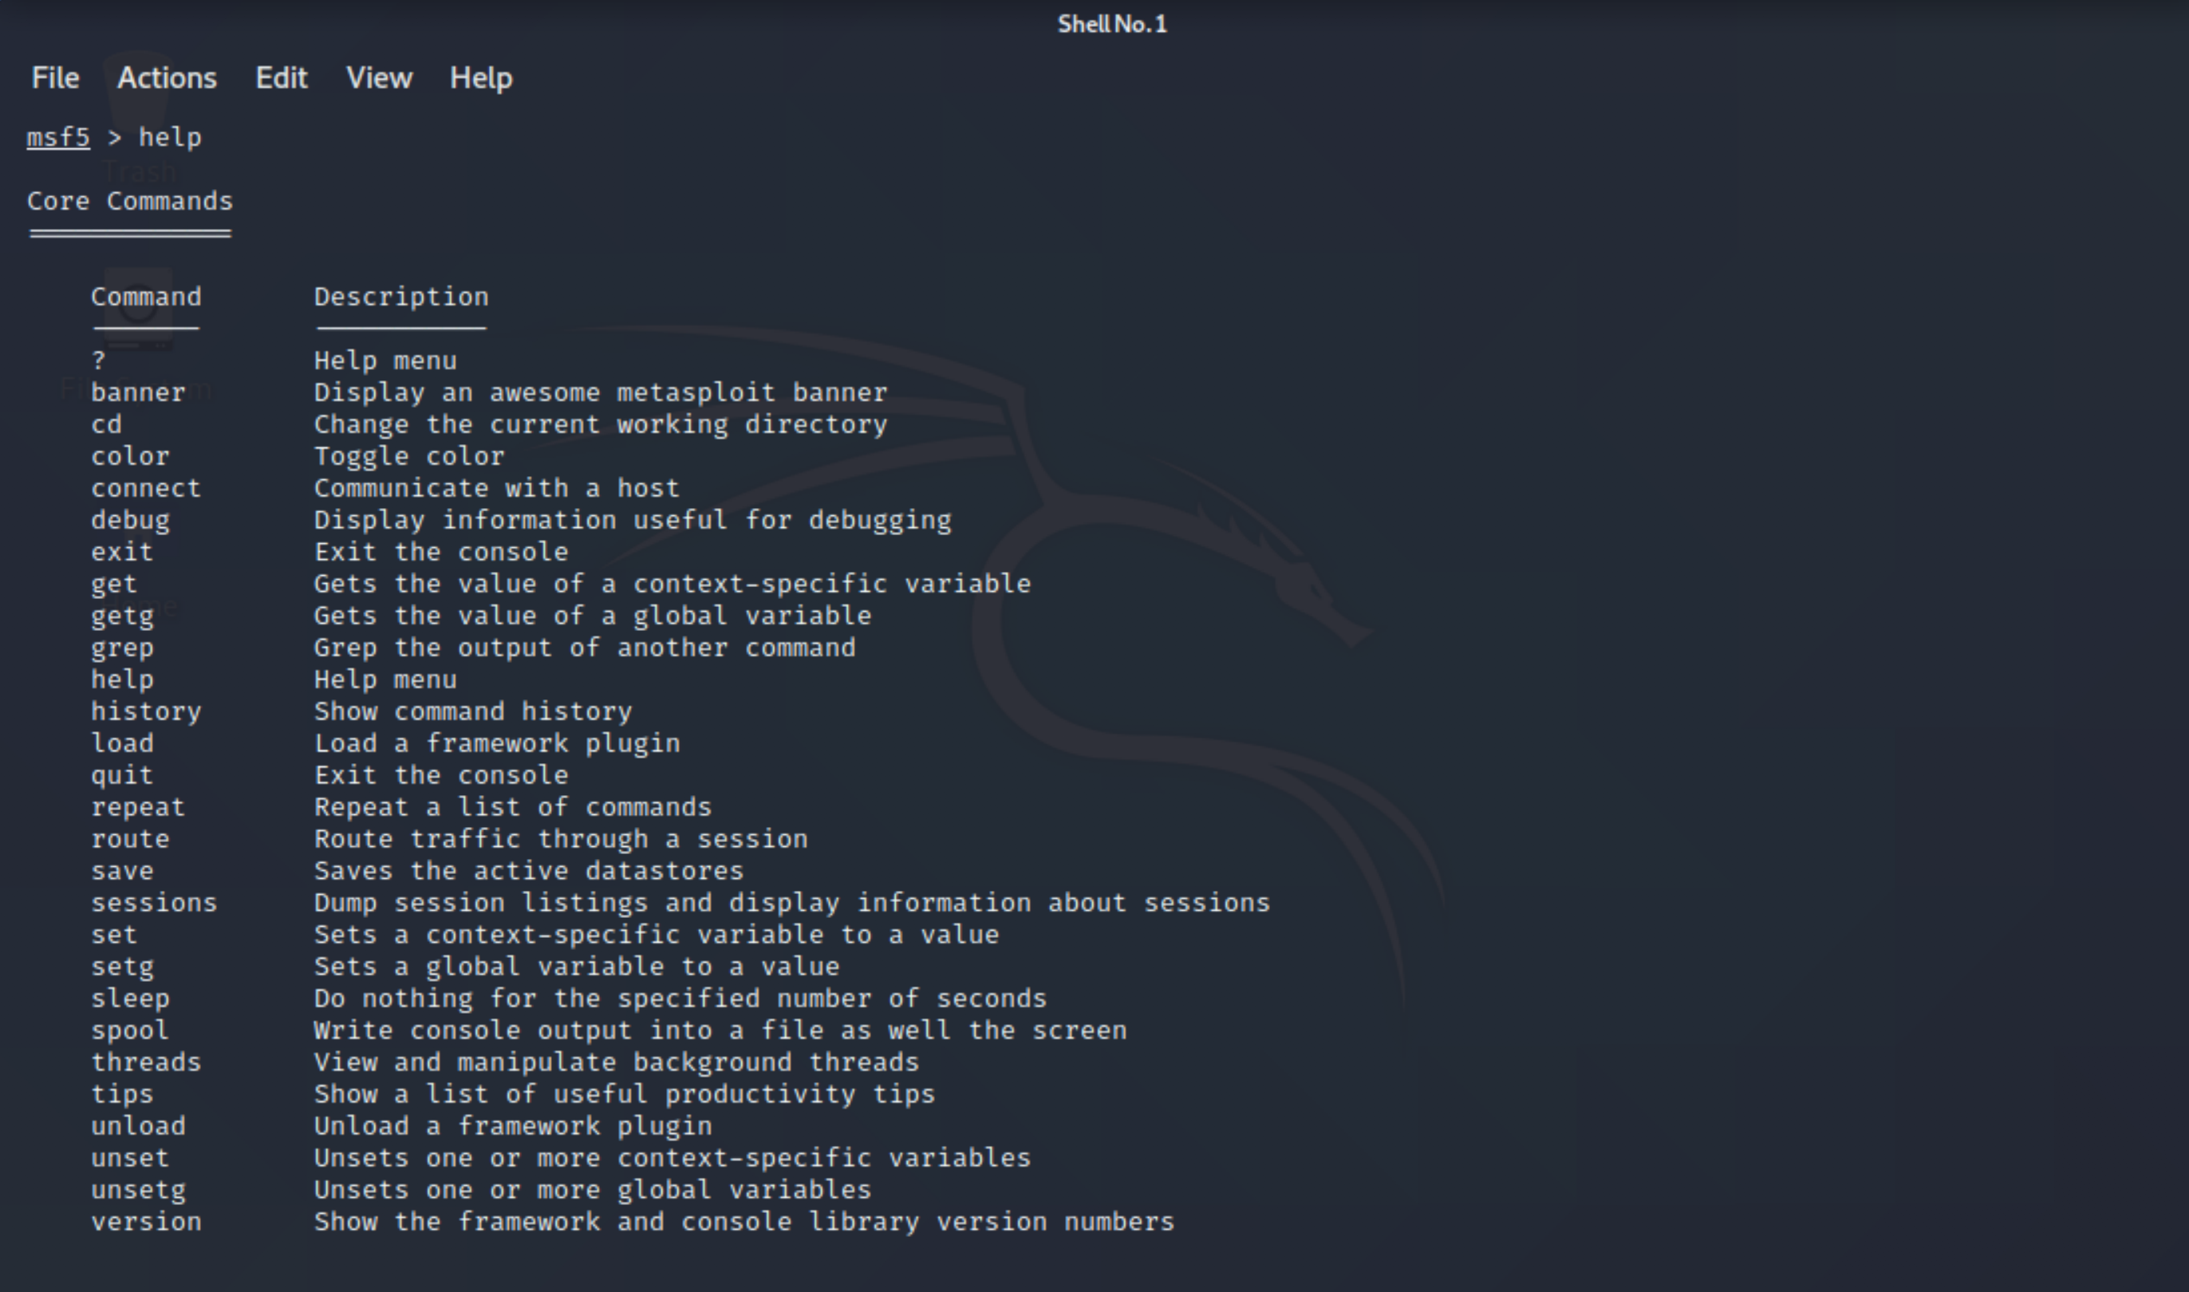

What can Metasploit do
The very first command I would use is “help”
This command will bring up a lot of actions Metasploit can do and what you should type for the appropriate action.

Slide 9
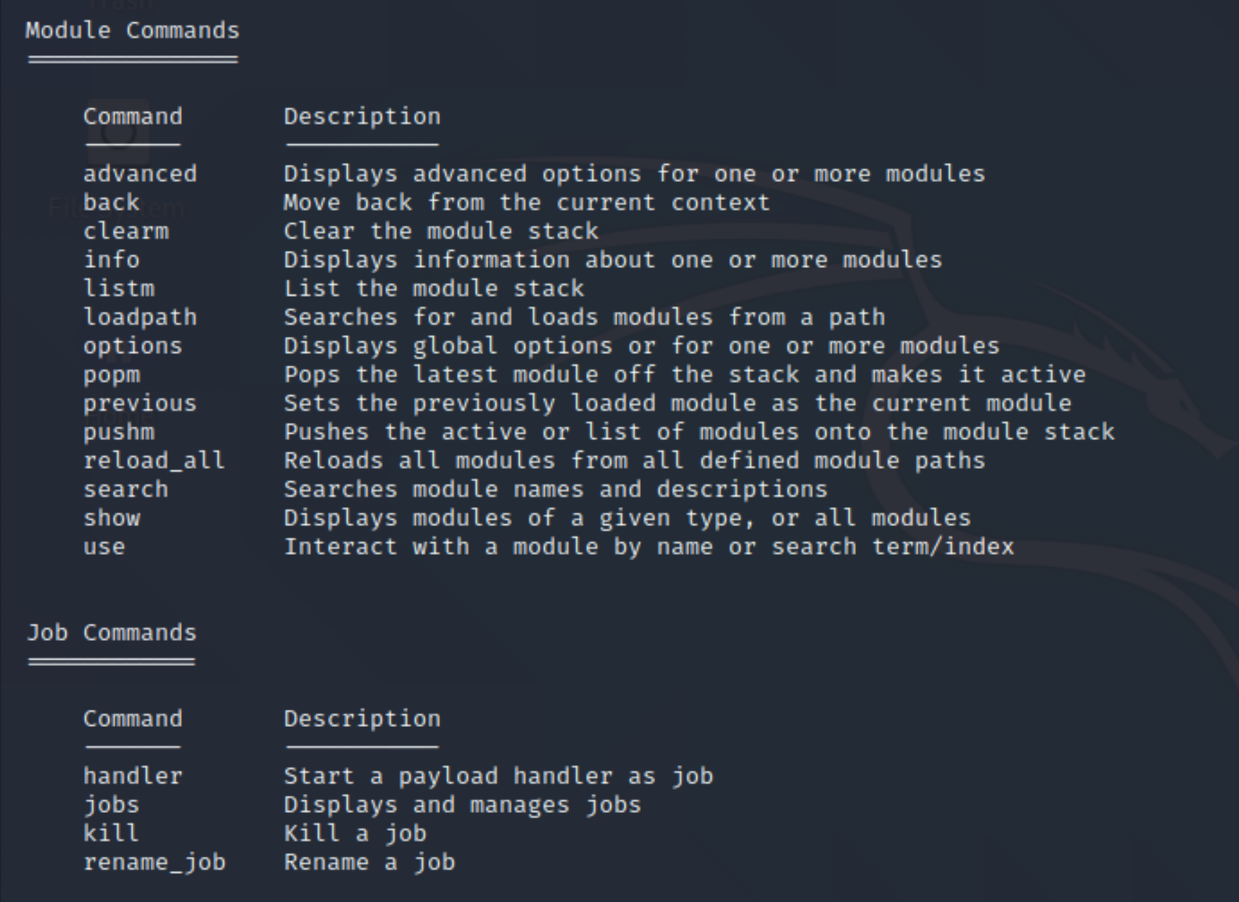
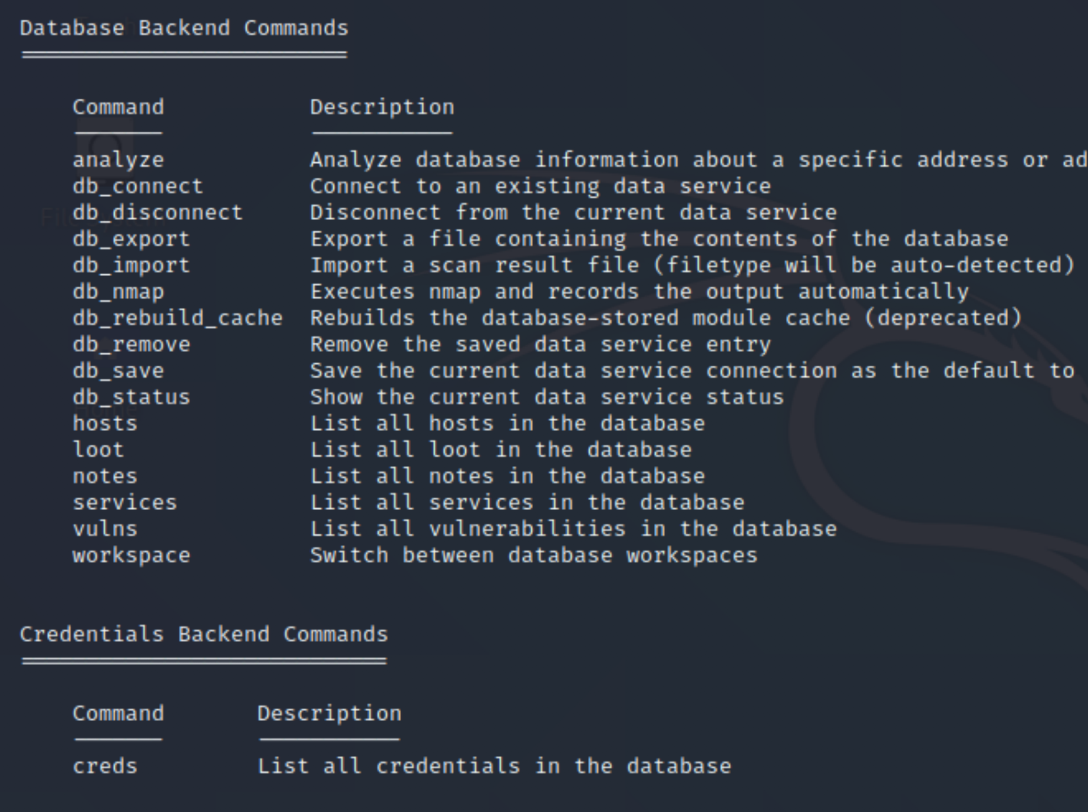
More info from “help”
The “help” command will give you as the user, a lot of assistance as it is very detailed and give a lot of depth into what's going on.
The “help” command also contains links to helpful resources that could further assist you.

Slide 10
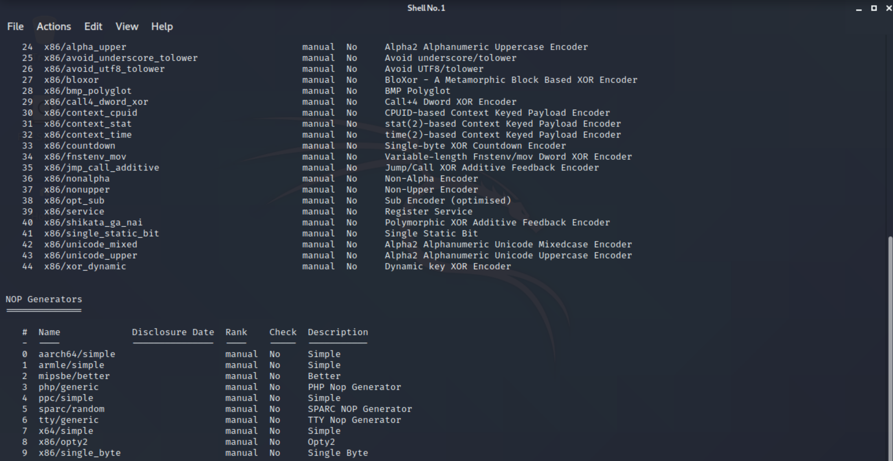
Let’s look at metasploits modules
When using the command “show all” this will prompt Metasploit to show you all the available modules within Metasploit

Slide 11

What else can “show” do?
The command “show” is used a lot when using Metasploit. The most frequent variants of “show” are
“show auxiliary” this command will show the user the auxiliary modules available within Metasploit.
“show exploits” this command will give the user a list of all exploits within Metasploit..
“show payloads” when this command is run it will show you all the available payloads for the exploit that you have chosen to run.
“show options” this command needs to be linked to an exploit and will give you all the settings available or required for the chosen exploit.
“show targets” this will show you all the available targets associated with your chosen exploit.
“show advance” will allow you to further fine tune your exploit by giving you more advanced options and settings.
“show encoders” will give you the list of encoders found within the Metasploit framework.
”show nops” this will display the NOP generators stored in the Metasploit framework.

Slide 12
“show exploits”

Slide 13
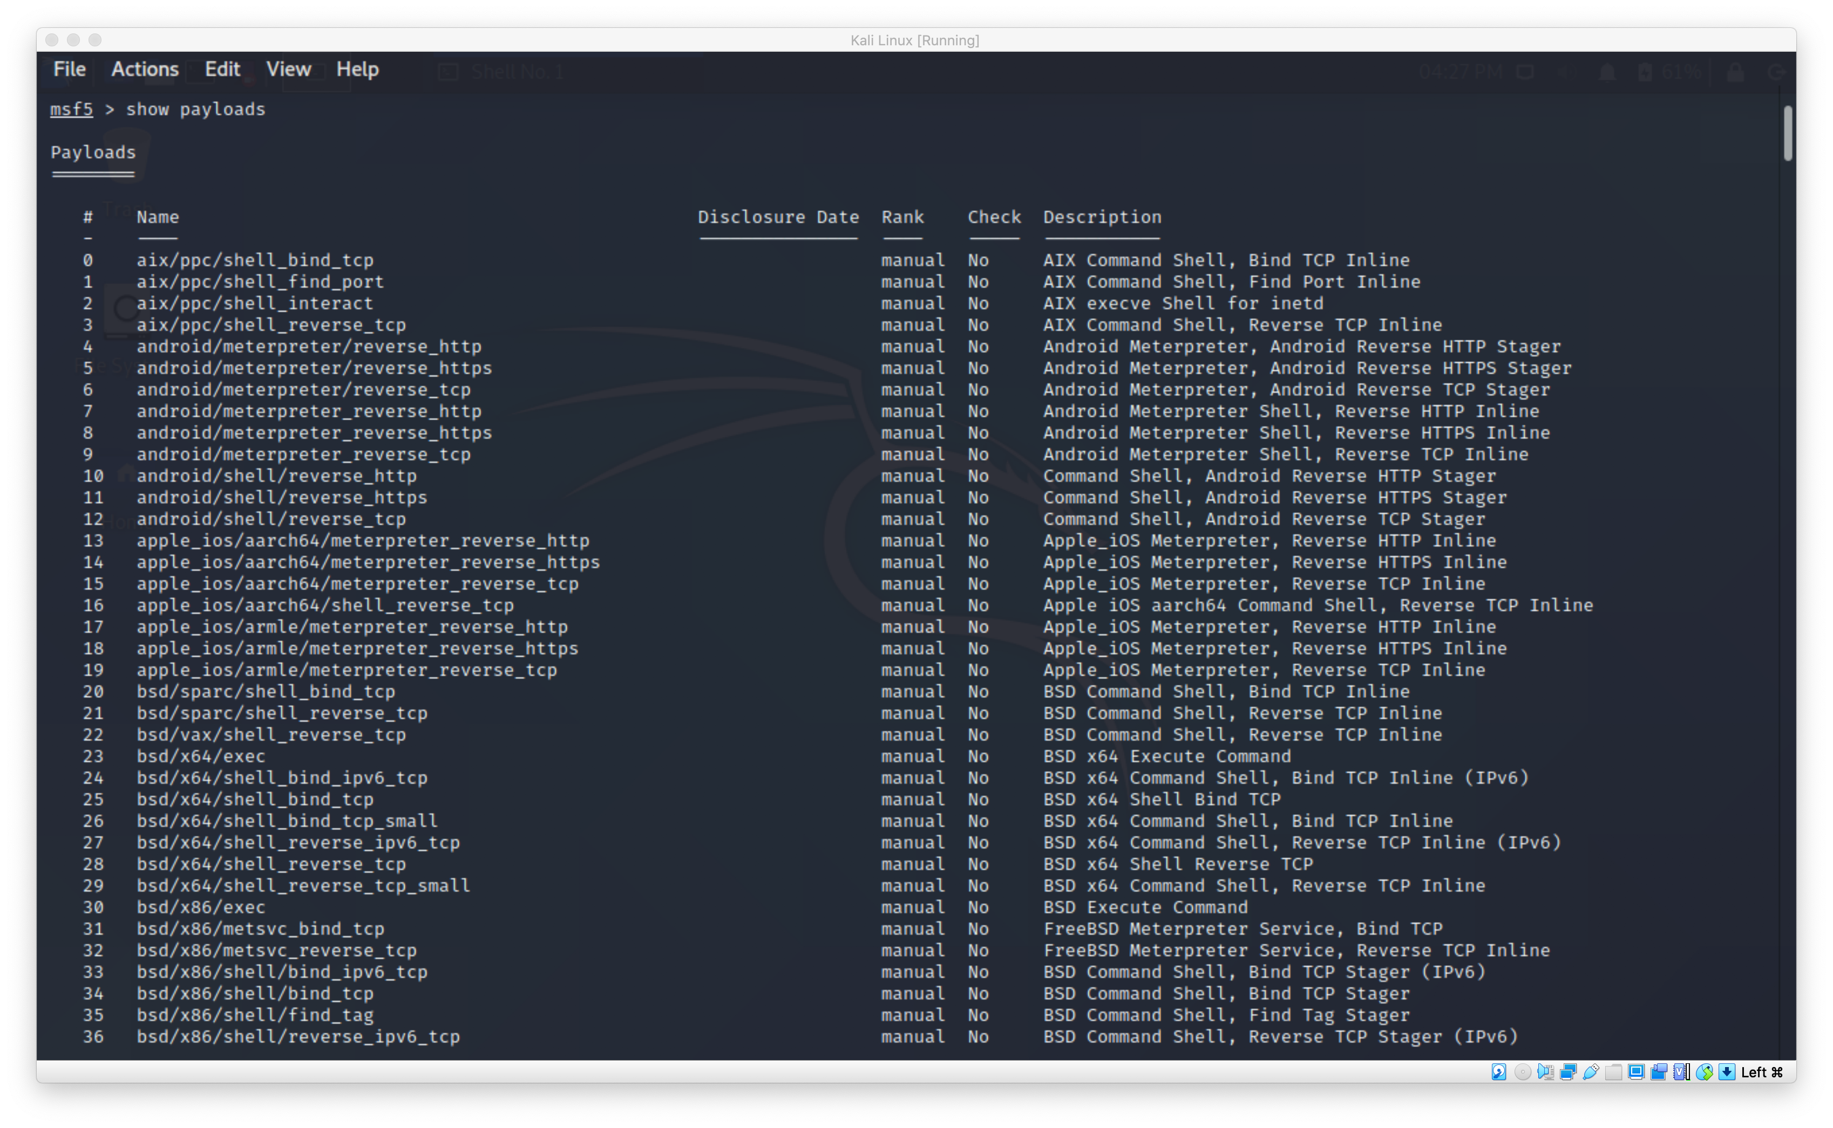
“show payloads”

Slide 14
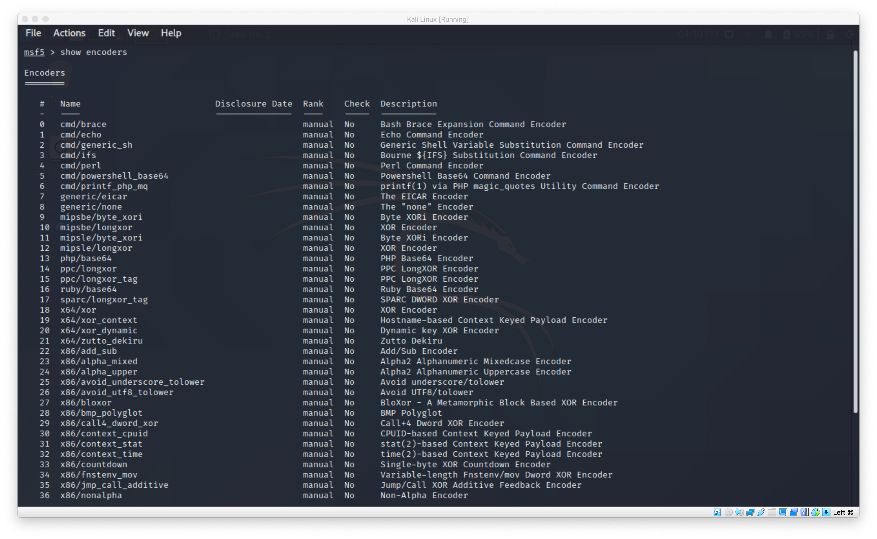
“Show Encoders”

Slide 15
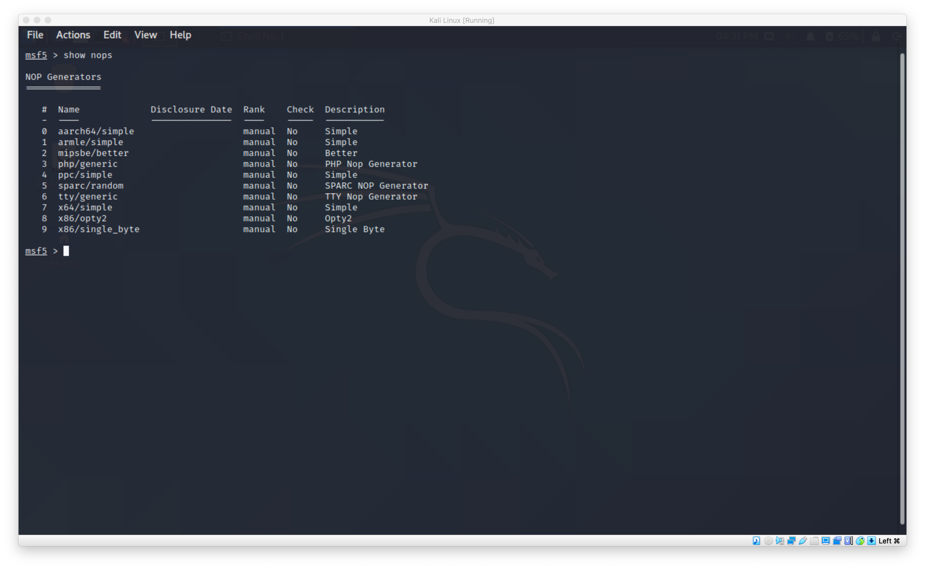
“show nops”

Slide 16
What else can Metasploit do ?
Using the command “info” will provide more details about the module being used and its suggested to always read this so that you don’t use a module that could do stuff you didn’t expect.
Using “jobs” will inform you of all the modules being run in the background.
Using “kill” will shut down any job as long as you supply the job ID.
There are many more commands at your disposal!

Slide 17

Warning!
Please be careful with how you use this software and remember to hack ethically and be safe.

Slide 18

Sources
https://www.offensive-security.com/metasploit-unleashed/msfconsole-commands/
https://www.offensive-security.com/metasploit-unleashed/msfconsole/
https://www.offensive-security.com/metasploit-unleashed/metasploit-fundamentals/
https://youtu.be/aRwxsn9ZEQw
http://robwillis.info/2016/08/metasploit-framework-basics-on-kali-linux-owning-a-windows-server/

Slide 19

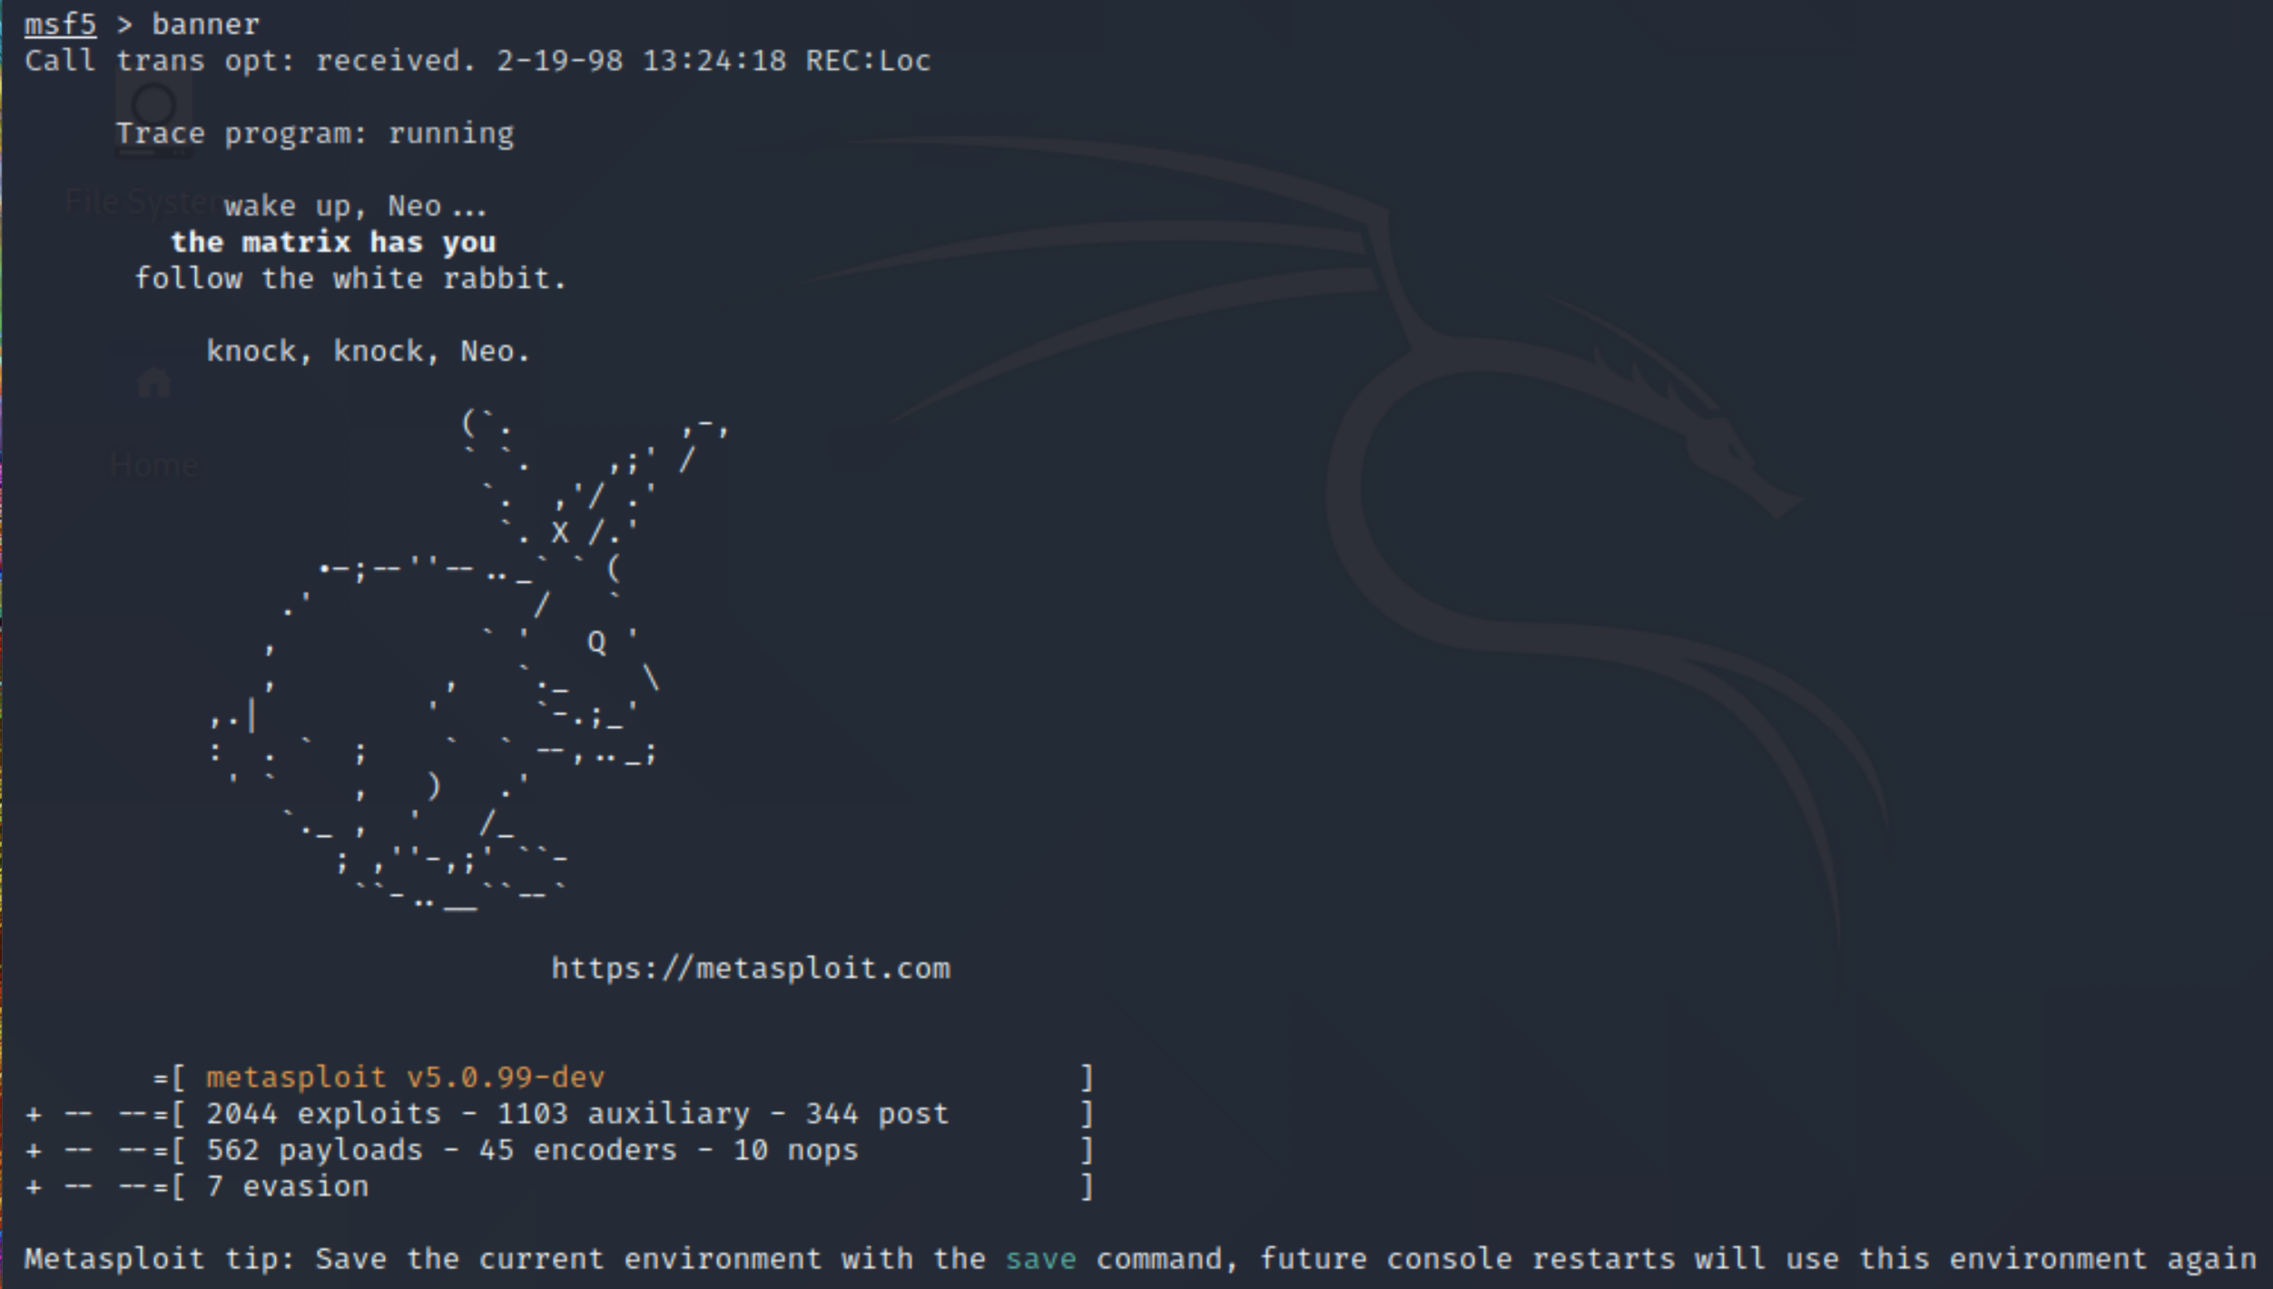
Thank you for listening!

